Slide 1

Bulk Sharing
Group 2

Slide 2
Participants’ Details
Total No of Interviews Conducted | 4
Average Duration of Interviews (Range) | 32 minutes
Average age range of the respondents | 25 - 35
Average Number of Devices | 3
Laptop + smartphone ownership | All

Slide 3
Summary Slide
From the interviews conducted this round, we have identified a few problem areas in the process of sharing files in bulk:
File selection: Selecting multiple files is cumbersome, especially on a phone which has limited screen area. Switching apps can quickly deselect everything, forcing the user to restart.
Notification of task completion: Notifying users at every stage – completion of file upload, sending of file, delivery of file, read receipt, errors, etc. – is important. Users value the confirmation and feedback they receive from the apps.
Maintaining connection: Several apps and features compel users to stay on the app or screen under the threat of halting the process otherwise. Providing users with a continuous, obstacle-free solution is key.

Slide 4
Themes and Insights
We understood bulk sharing as sharing files within a personal device ecosystem, sharing one file with many recipients, sharing many files with a single recipient and sharing many files with many recipients.
Bulk Sharing
Device Use
Content Management
Methods and Challenges
Security and Privacy

Slide 5
Device Use, Integration and Interactions
Personal and professional tasks are separated; devices and services are segregated according to the nature of tasks accordingly.
“On my iPhone, I handle communication tasks like emails and calls, while on my MacBook, I edit photos and videos for my freelance work. My iPad is more for leisure, like reading and browsing.” [P2.4. 25, Male, Journalist, iOS and Windows user]
Bulk Sharing in Personal Ecosystem vs with Contacts
“Sure. If I need to share a large number of photos with a client, for example, I usually create a shared album on iCloud and then send the link via email or messaging apps. It's a straightforward process.” [P2.4. 25, Male, Journalist, iOS and Windows user]

Slide 6
Content Management and Organisation
Cloud services are preferred with larger file sizes but when privacy becomes is a concern, the preference changes to other apps.
Older users may still prefer to manually organise their files on a laptop computer, but new features in phones acclimatise them to automatic organisation and sorting.
”if the size is big then I would prefer cloud otherwise WhatsApp. And if [it is a] stranger, I might use Discord or Telegram” [P2.1, 23, Male, iMtech student, Samsung smartphone user]
“If it [the file] is around 100 MB to 1GB, I zip it and send; if it's more than 1 GB, I use cloud so that it won’t get compressed.” [P2.1. 23, Male, iMtech student, Samsung smartphone user]
“I organise my files only on laptop, not on my phone. I create a hierarchical structure of folders. For each business folder, I have year-wise folders from 2012-13 to 2024-25. In my phone, photos are automatically organised. But I have manually organised my song files according to artists.” [P2.3. 61, Male, entrepreneur, iPhone and PC user]

Slide 7
Methods, Challenges and Preferences
Phone to laptop transfer is clearly a challenge, especially when they are not of the same brand or ecosystem. A clear preference for AirDrop is demonstrated across age groups for cross-OS, cross-platform transfer due to fewer steps and simplicity of use.
“Yeah, I wish there was something like AirDrop. As I use a Microsoft laptop, … I think if there is something like AirDrop between my mobile and my laptop, it would be very helpful for me to transfer files without using WhatsApp.” [P2.2. 24, Male, iMtech Student iOS and Windows User]
“Transferring from my phone to the laptop is not smooth because iOS has a lot of complicated steps. If there were a simple feature like AirDrop, things would be easier. Using a cable and other methods, I feel, is complicated. It was so painful the first time I did it that I never tried it again.” [P2.3. 61, Male, entrepreneur, iPhone and PC user]
If we can transfer wirelessly, like we play music, as simple as that. We turn on the speaker and the phone identifies the device after turning on Bluetooth. Just after tapping on that, music starts playing on the speaker. Similarly, if the phone can identify the laptop and easily send files, it would be very helpful. And vice-versa. [P2.3. 61, Male, entrepreneur, iPhone and PC user]

Slide 8
Security and Privacy
“I mostly prefer built-in device features because of privacy concerns with third-party apps. So I usually prefer to use the AirDrop feature as it's very secure, especially on iOS devices” [P2.2. 24, Male, iMtech Student iOS & Windows User]
“Only thing I've done is to make sure in the settings that people cannot simply pull me into WhatsApp groups - they need my permission. I'm more concerned about money transfers made through the phone.” [P2.3. 61, Male, entrepreneur, iPhone and PC user]
As I use only in-built options or well-known apps like WhatsApp, I don't think my privacy is getting violated. Even then, there's still fear [about] privacy. I don't have other options so I'll stick with this. [P2.2. 24, Male, iMtech Student iOS and Windows User]
Concerns of privacy and security are subliminal - users know they exist but they don’t think they need to act on it yet. There is trust in existing apps and features but also a sense that it is out of their control.

Slide 9
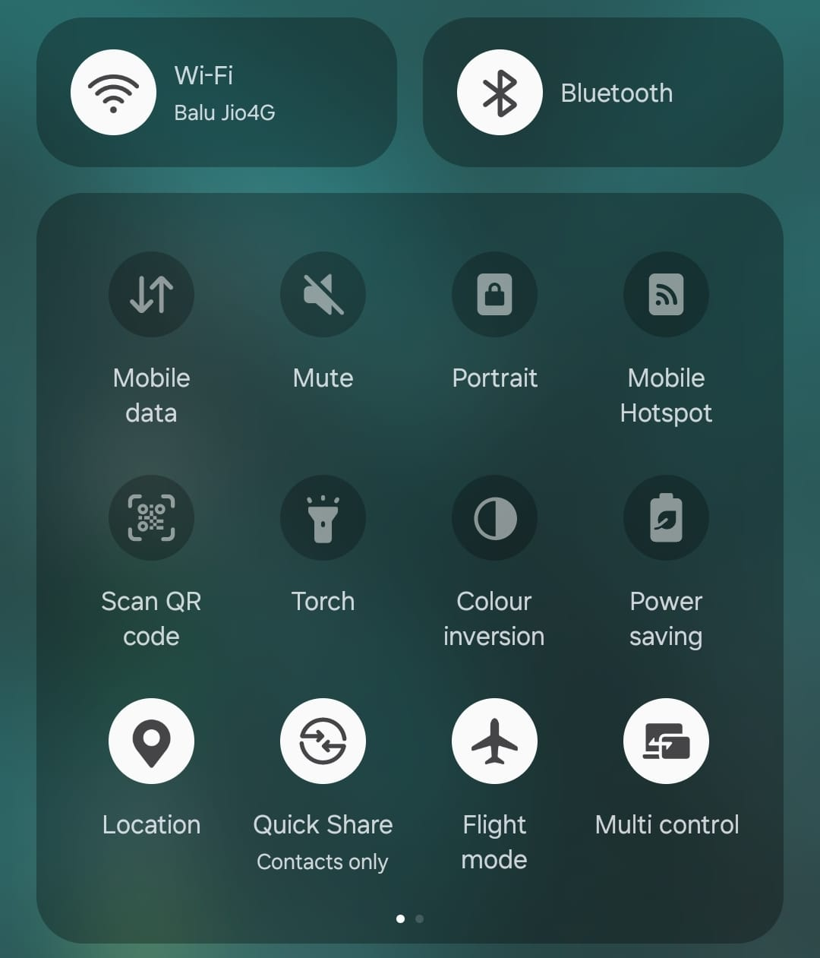
When connected to a WiFi network but not cellular connectivity, senders can share files with nearby Quick Share users.
But if the sender wants to share via Quick Share to an existing contact for the first time, they are unable to do so and an error message appears stating, "Please insert SIM Card and try again."
If the user selects a contact from the share sheet in Quick Share, the file seems to upload and send, but the receiver does not receive the file.

Slide 10
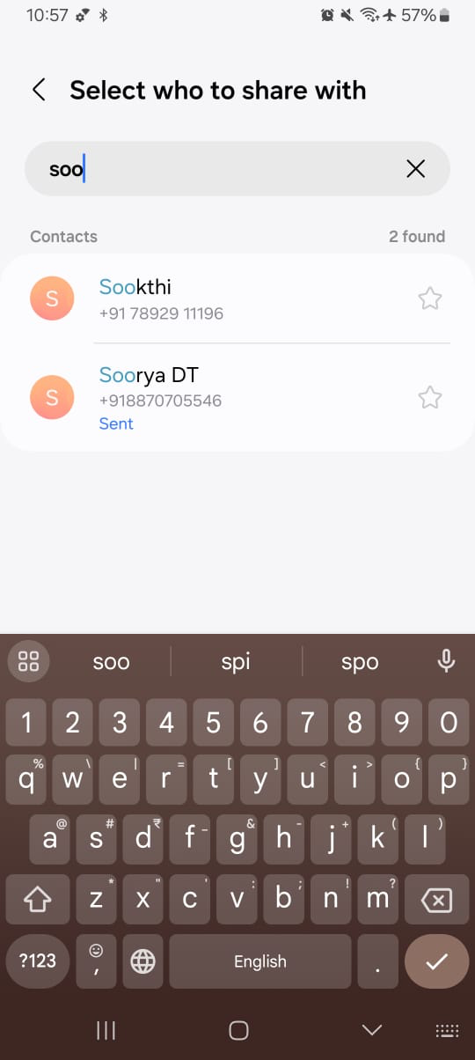
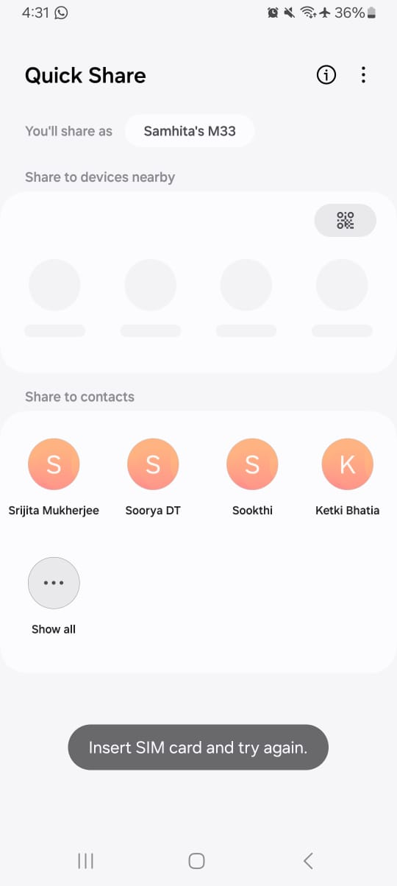
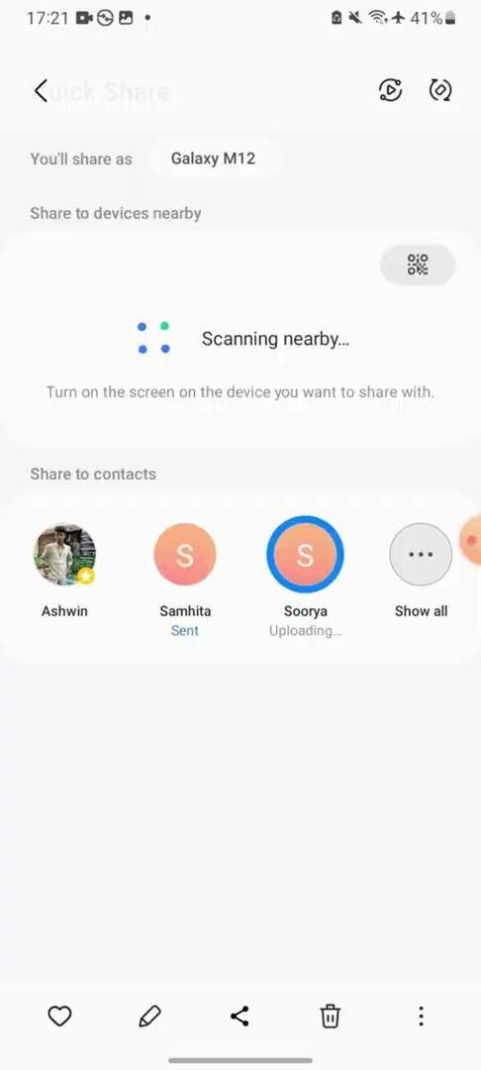
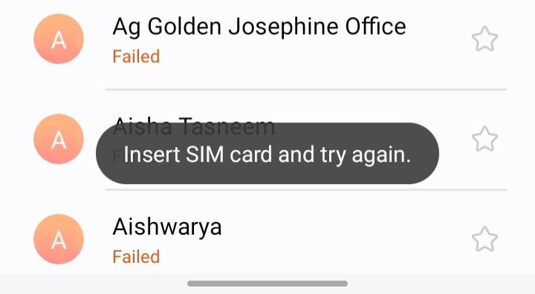

Slide 11
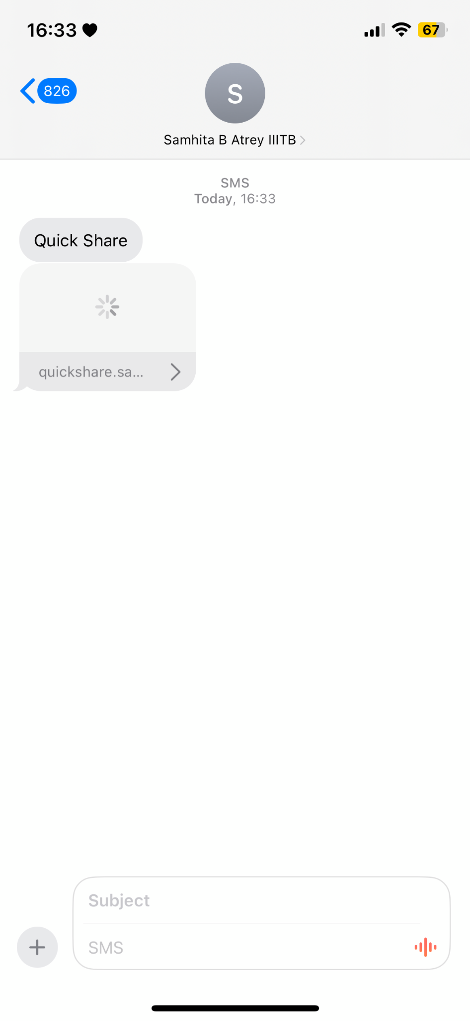
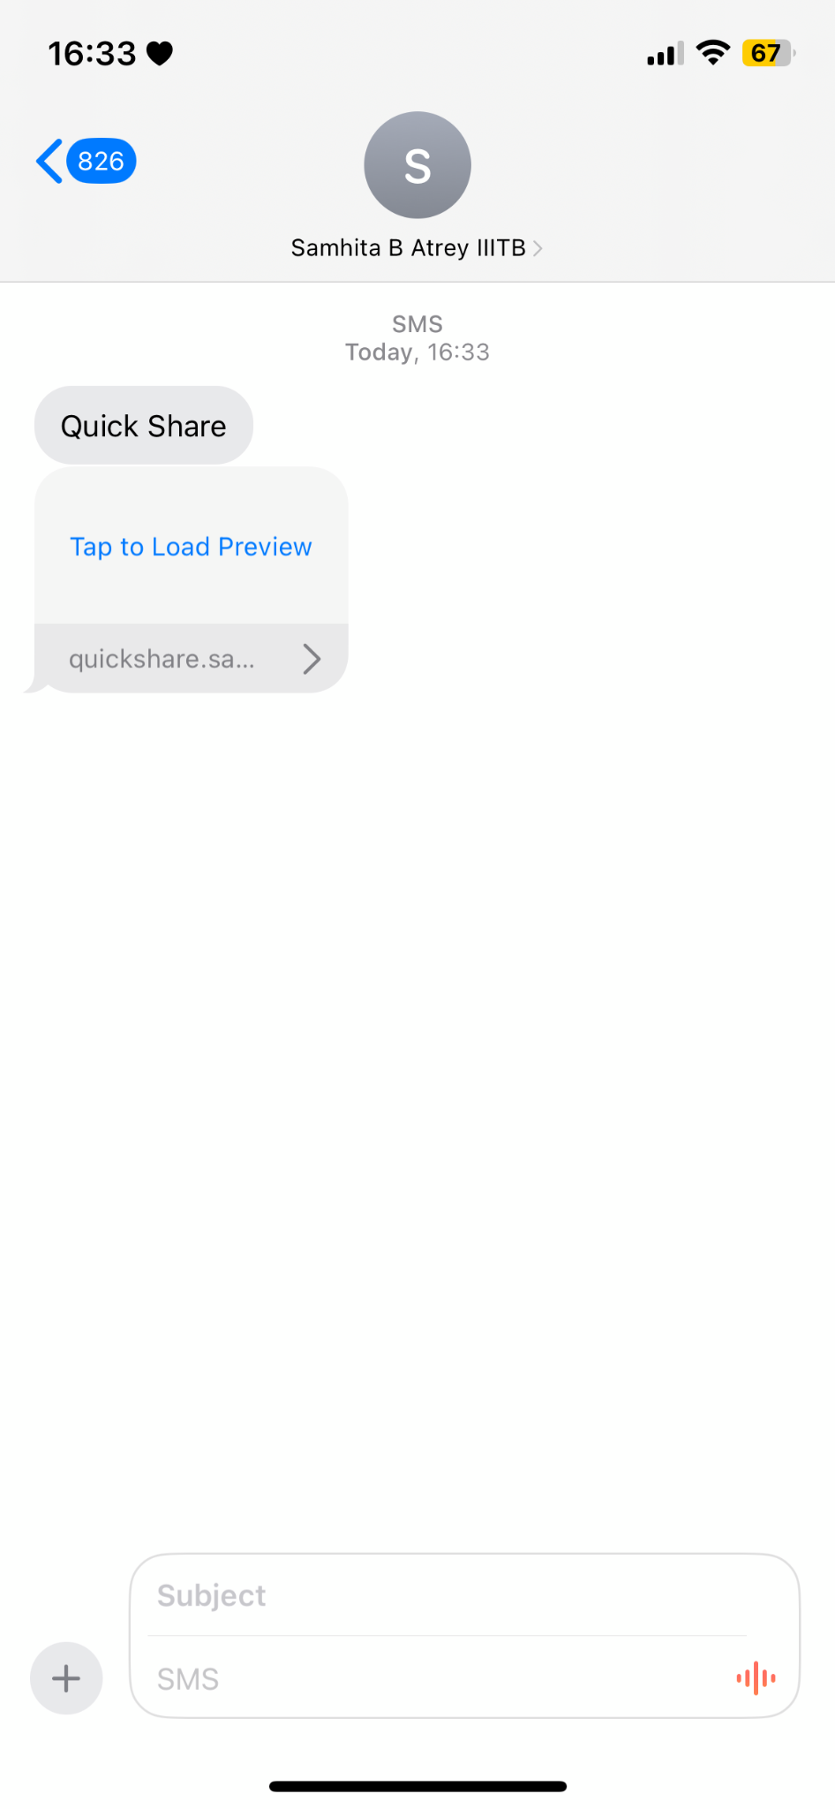
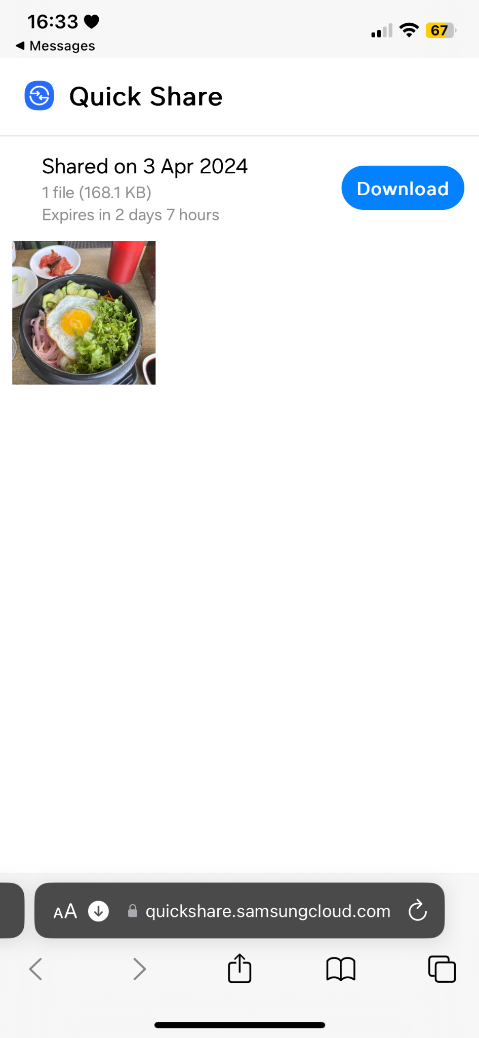
Single sharing
On receiving a file through Samsung Quickshare, a non-Samsung user receives a link over a text message. And the process of viewing and downloading the file involves the following steps.
The Tap to Load Preview takes quite some time and then opens up in the default browser
Opens in Default Browser
Receives as a Text Message

Slide 12
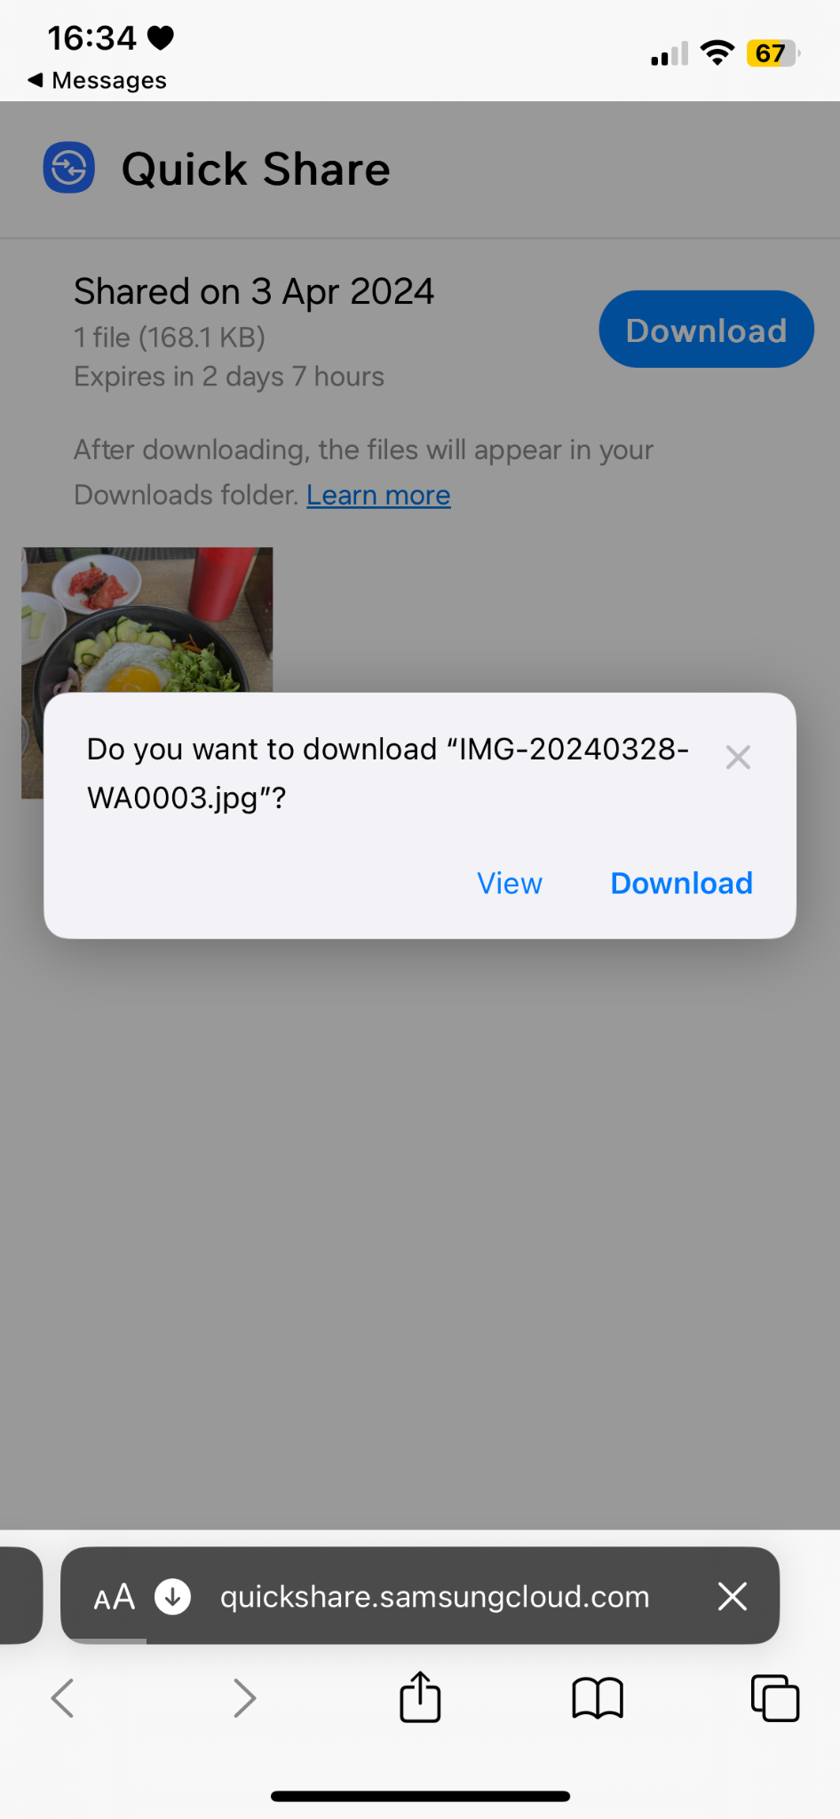
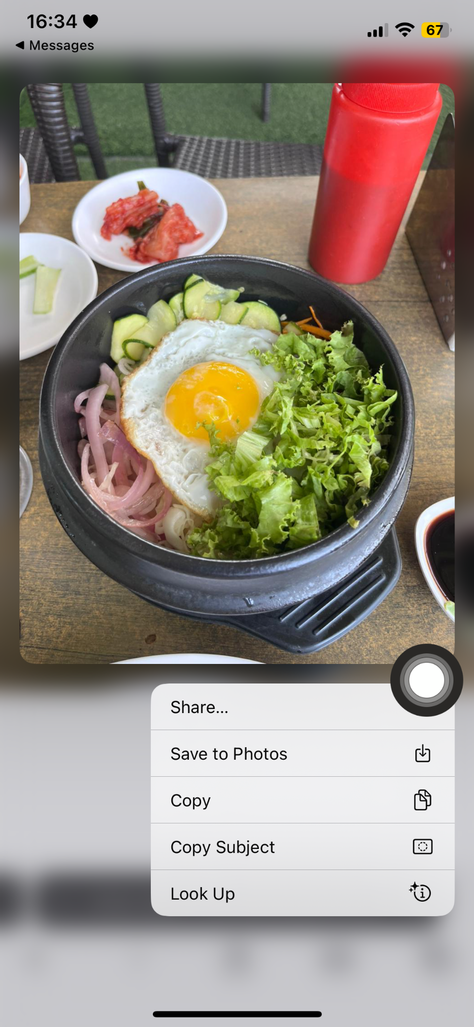
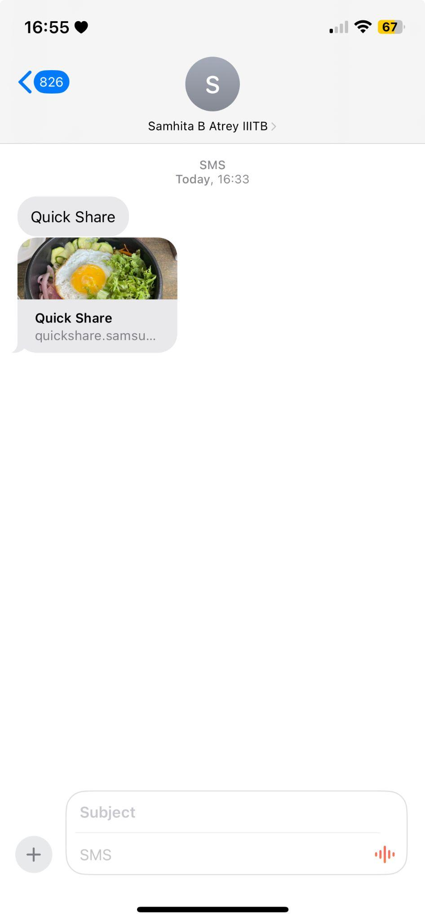
Single sharing
On clicking Download, the image will get saved in the Download Folder, and is not visible in Gallery
Another Shortcut to save the image
On Checking the Text later

Slide 13
Design Recommendations
Ability to send one or many files to multiple contacts.
A feature to indicate that the recipient has received the file(s) – a delivery notification.
A push notification before the link expires (“The file expires in 5 hours 59 minutes. Click to Review.”)
An option to include/exclude select contacts while sharing with groups.

